Slide 1
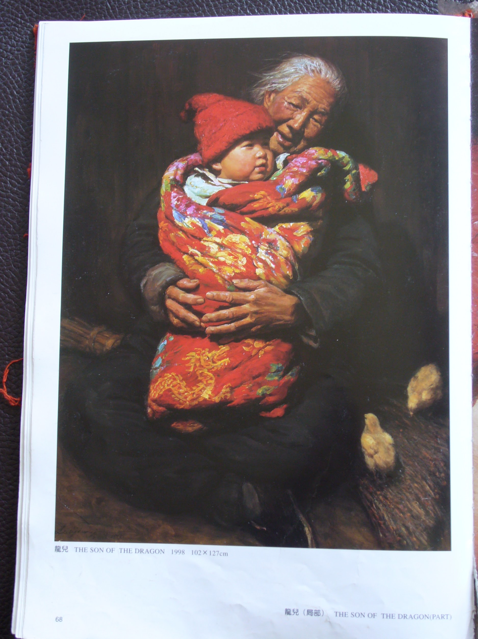
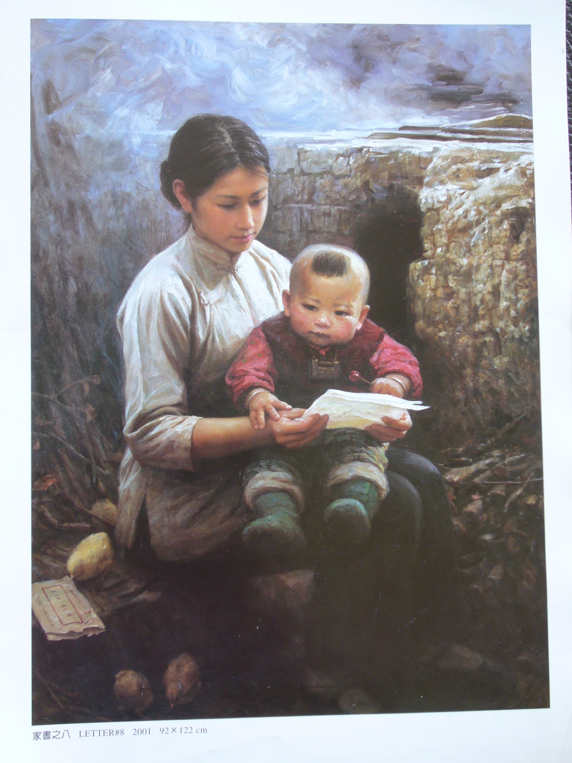
Passing on a Legacy 传承属灵遗产 A Grandmother, a Mother and a Boy 一位外祖母、一位母亲和一个男孩

Slide 2
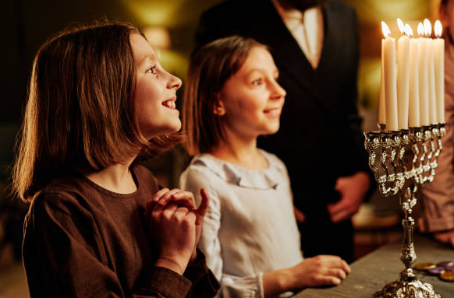

Slide 3
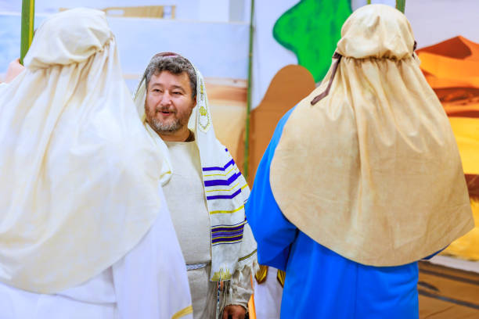

Slide 4
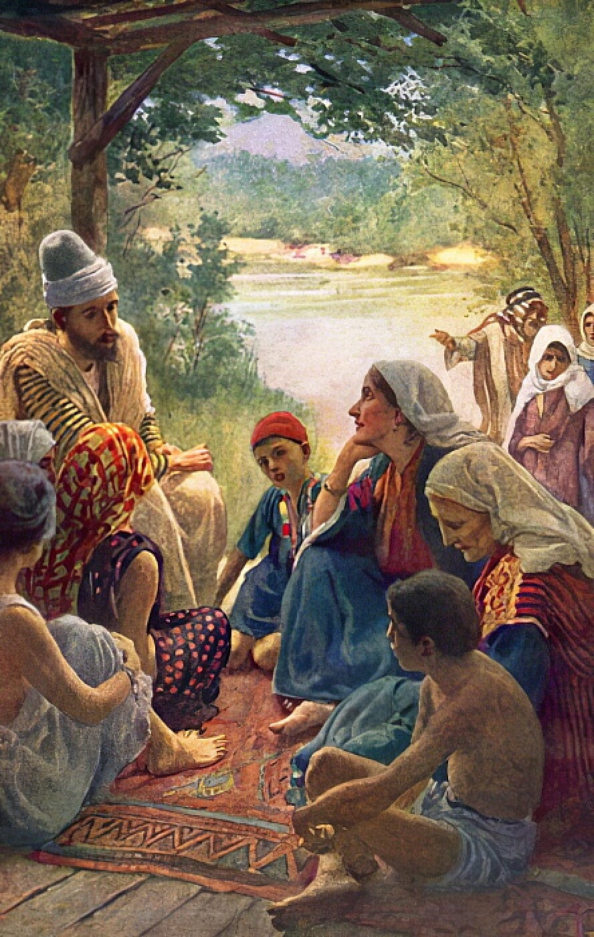

Slide 5
1. Instill a Respect for Scripture 培养对圣经的敬重
“…continue in what you've learned and become convinced of, because you know those from whom you learned it." II Timothy 3:14
“ …….但你所学习的、所确信的，要存在心里，因为你知道是跟谁学的” 提摩太后书 3：14

Slide 6
1. Instill a Respect for Scripture 培养对圣经的敬重
“…and how from infancy you’ve known the holy Scriptures, which were able to make you wise for salvation through faith in Jesus Christ.” II Timothy 3:15
“…并且知道你是从小明白圣经，这圣经能使你因信基督耶稣有得救的智慧。” 提摩太后书 3：15

Slide 7
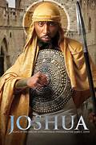
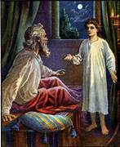
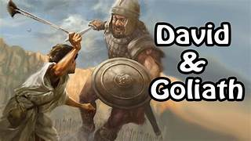
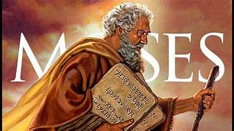
Heroes of the Faith信心的英雄
Samuel

Slide 8
1. Instill a Respect for Scripture 培养对圣经的敬重
“ These commandments that I've given you today are to be upon your hearts. Impress them up on your children. Talk about them when you sit at home and when you walk along the road, when you lie down and when you get up.” Deuteronomy 6:6-7
“我今日所吩咐你的话都要记在心上；也要殷勤教训你的儿女，无论你坐在家里，行在路上，躺下，起来，都要谈论。” ——申命记 6:6–7

Slide 9
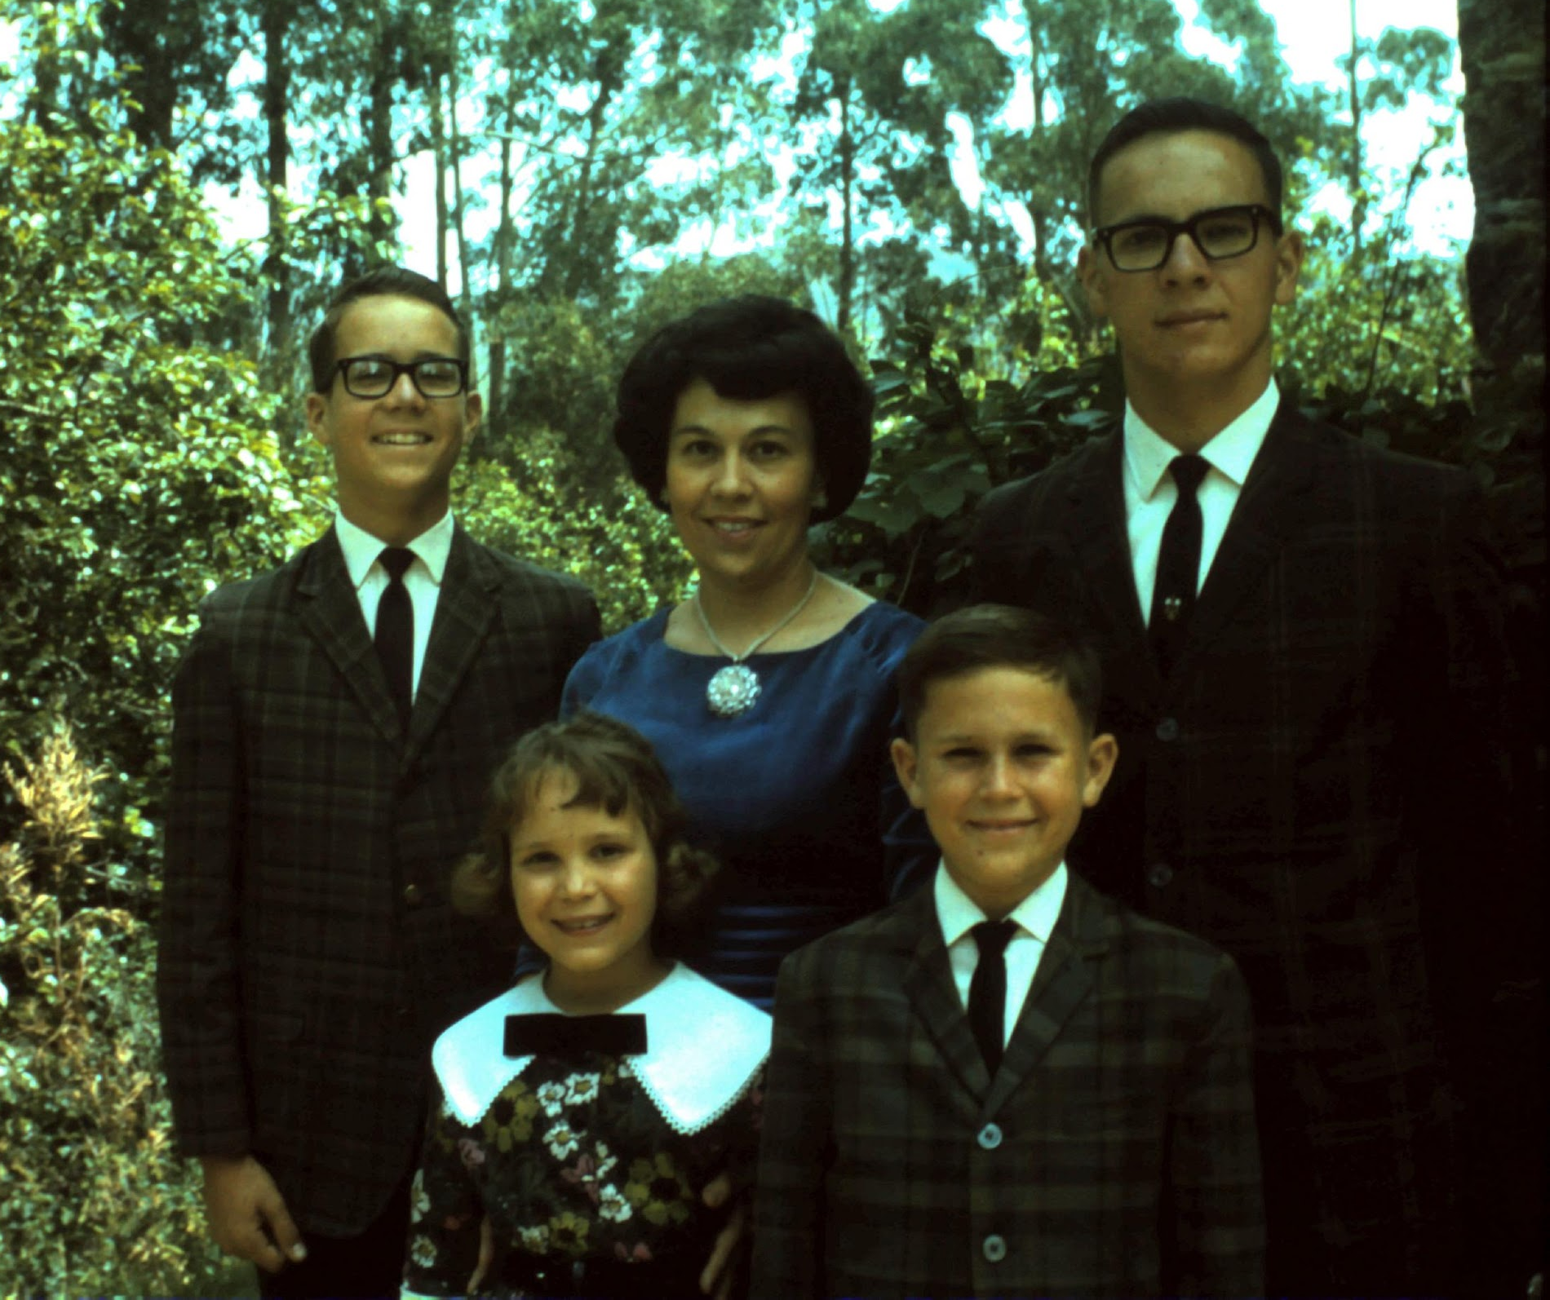

Slide 10
Mom’s verse for her children 妈妈送给孩子们的经文
我听见我的儿女们按真理而行，我的喜乐就没有比这个大的。 约翰三书 4节

Slide 11
“When I am afraid, I will trust in God.” Psalm 56:3 “我惧怕的时候要倚靠你。”诗篇 56：3

Slide 12
2. Instill an Authentic Faith 培养真实的信仰
"I have been reminded of your sincere faith, which first lived in your grandmother Lois and your mother Eunice and, I am persuaded, now lives in you also.” 2 Timothy 1:5
“我想起你真诚的信心，这信心是先在你祖母罗以和你母亲友尼基里， 我深信，也在你里面。” ——提摩太后书 1:5

Slide 13
“My mom says she's not in.” 我妈妈说她不在

Slide 14
“I helped cry with her.” 我陪她一起哭。

Slide 16
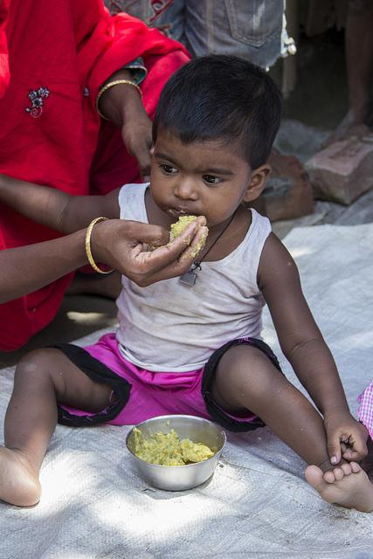
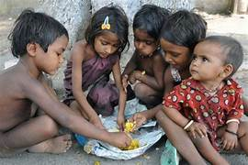
“I was hungry and you fed Me.” 我饿了，你们给我吃

Slide 17
3. Instill a Desire to Serve 培养服侍的心志
"I have no one else like him (Timothy), who takes a genuine interest in your welfare. But you know that Timothy has proved himself…he has served with me in the work of the gospel.” Philippians 2:20,22
“我没有别的人像他（提摩太），他真心关心你们的事。你们也知道，提摩太已经证明了自己，他与我一同在福音的工作上事奉。” 腓立比书 2:20, 22

Slide 18
“For what does it profit a person if they gain the whole world and lose their soul? Mark 8:36
人若赚得全世界，却赔上自己的生命，有什么益处呢？
马可福音 8:36
“As the Father has sent Me, so I send you.” John 20:21正如父差遣了我，我也照样差遣你们。

Slide 19
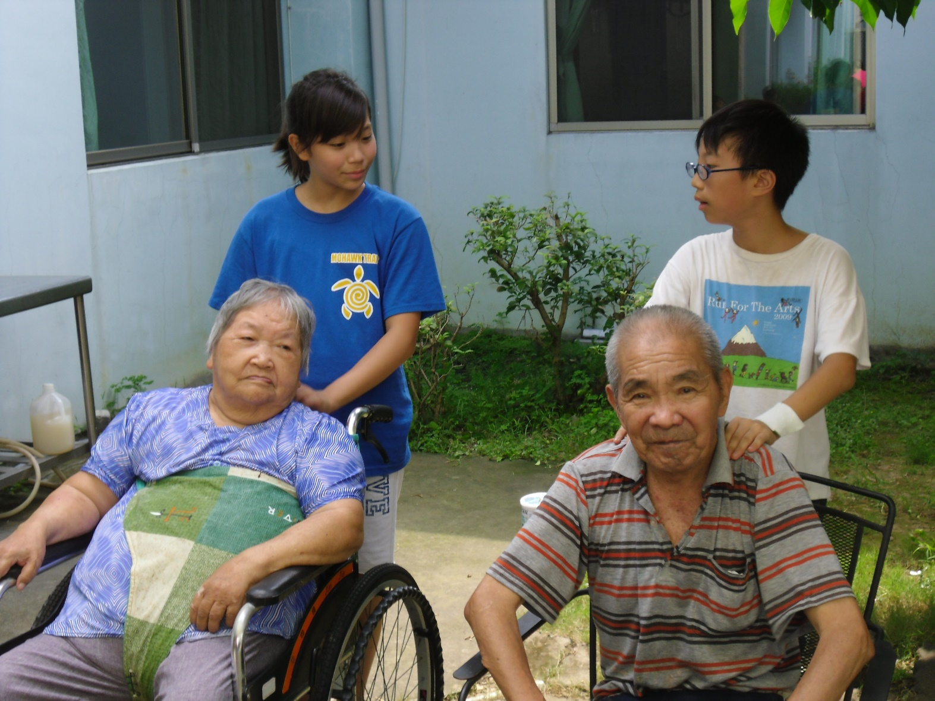
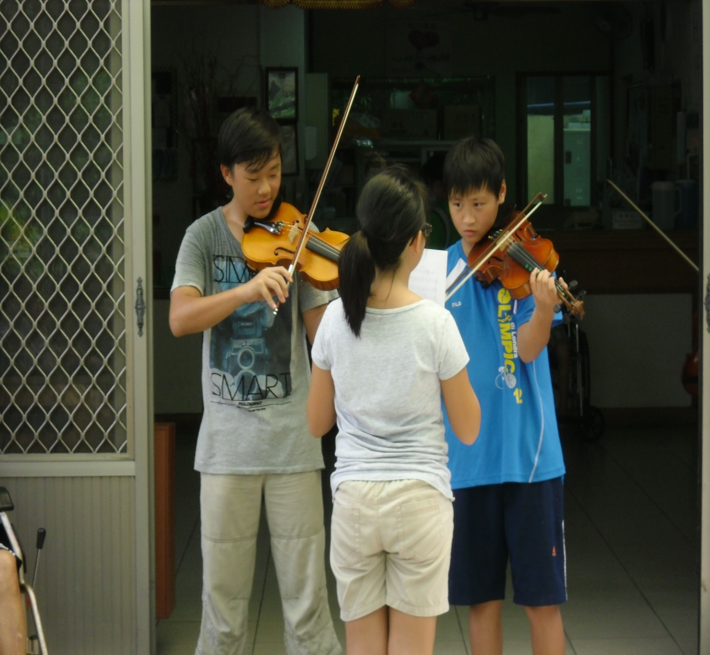
Visiting a Senior Citizen’s Home 拜访养老院

Slide 20
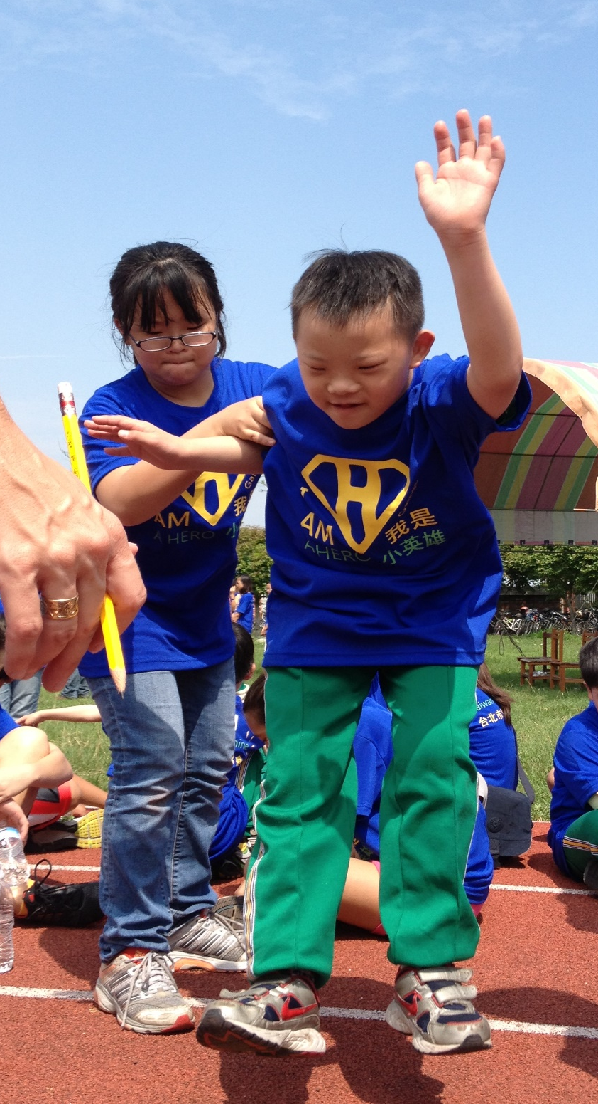
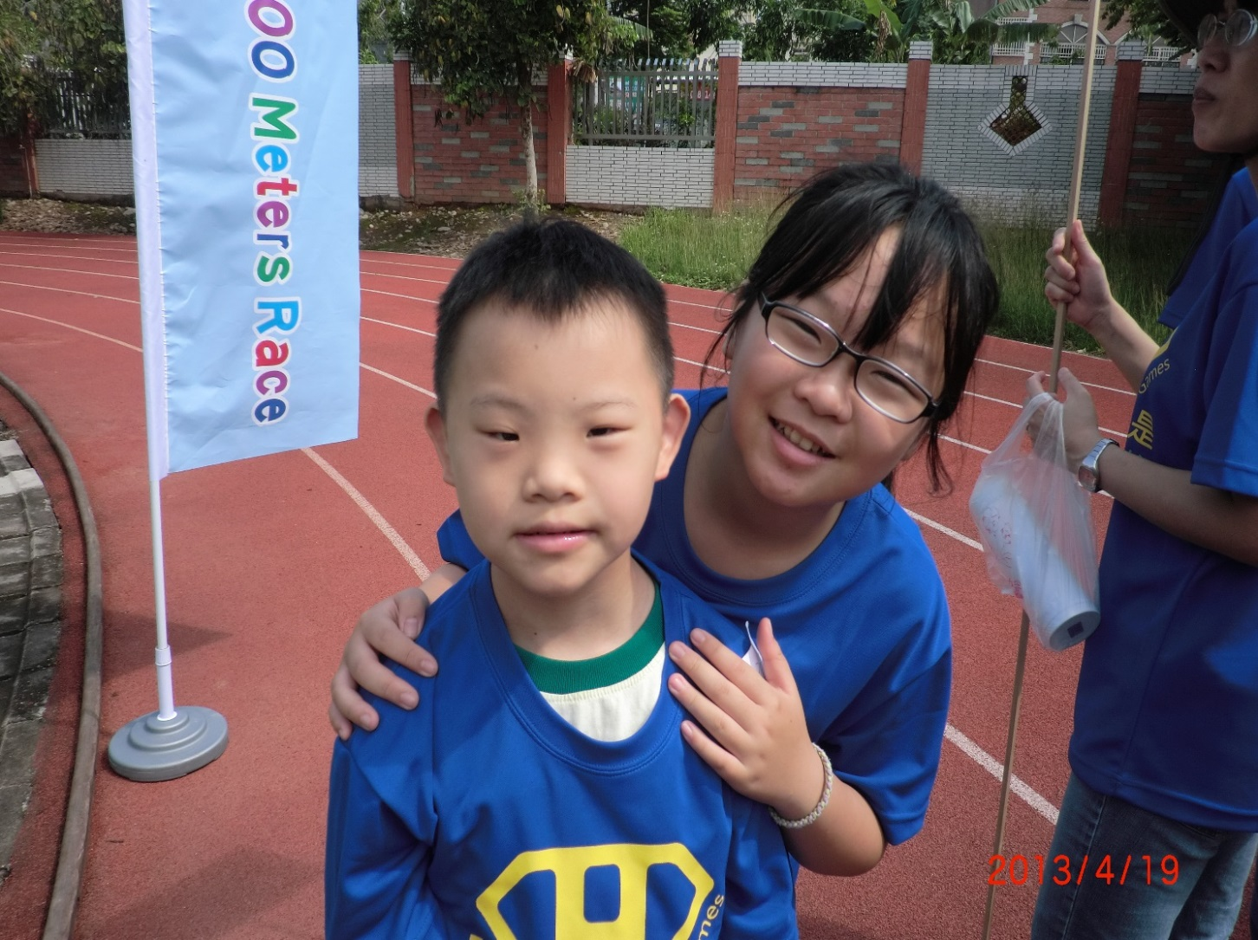
Helping in Special Olympics 帮助残疾孩子参加运动会

Slide 21
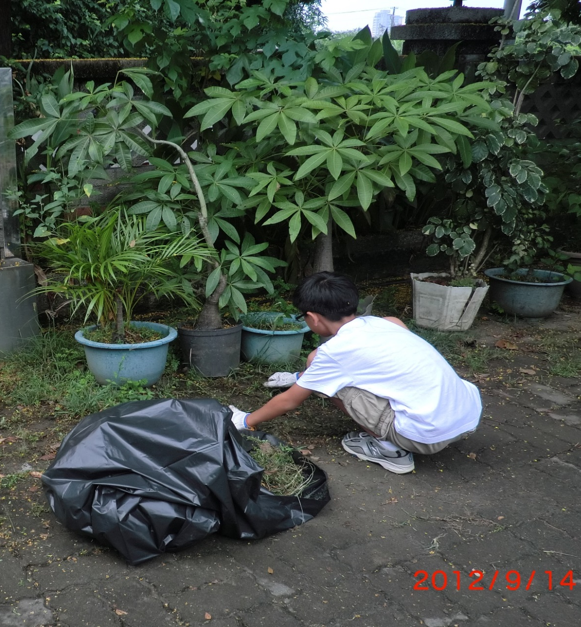
Cleaning up the Community 清理社区

Slide 22
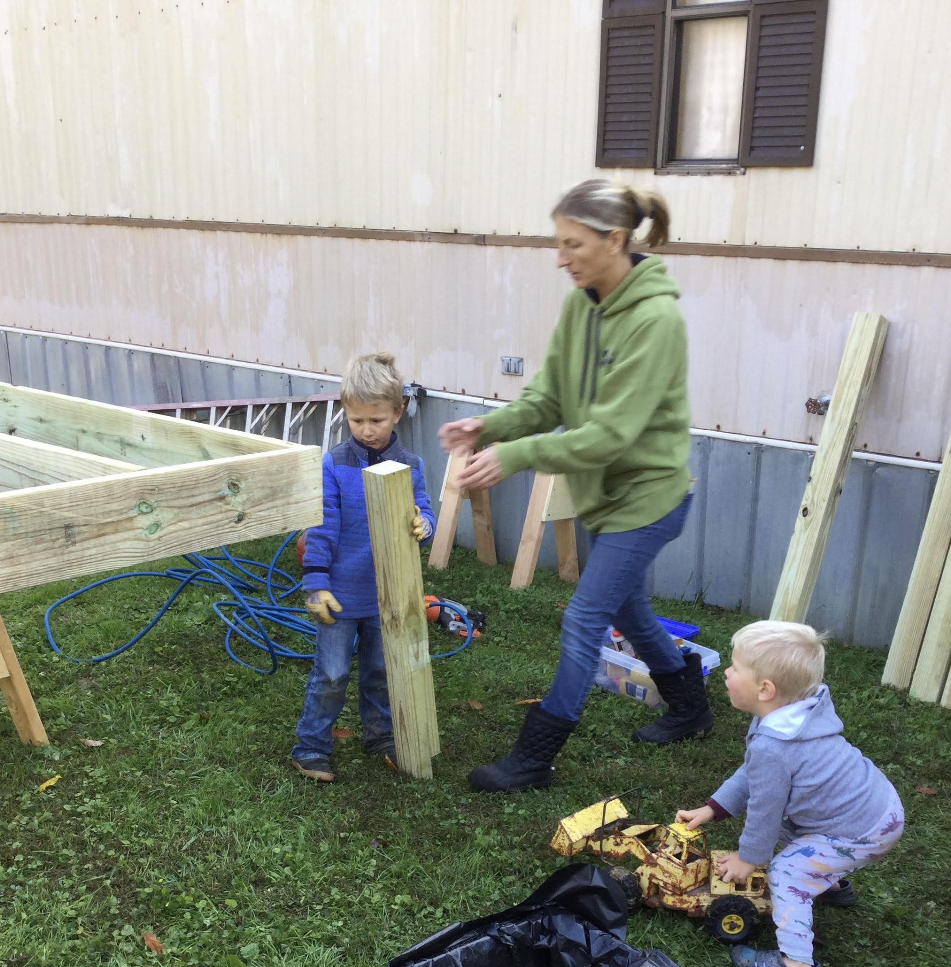
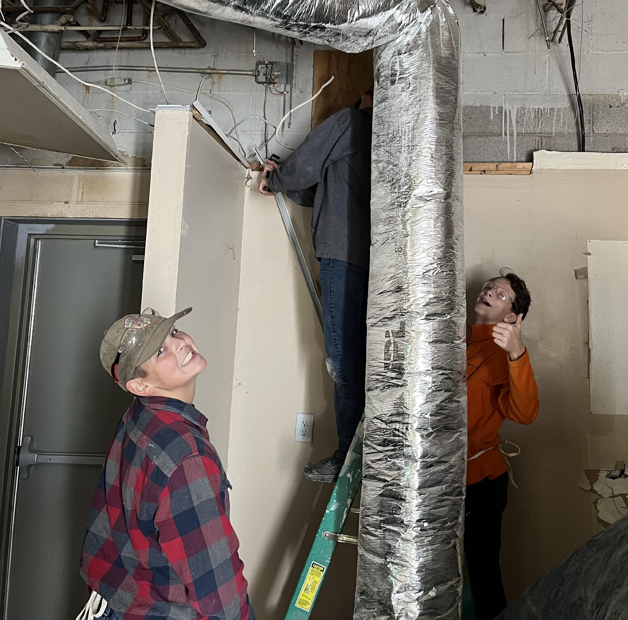
Building a porch for elderly woman
给老年妇女家修建门廊
Repairing building for homeless shelter
维修收容所的房屋

Slide 23
Passing the Towel of Service 传递服侍的毛巾

Slide 24
Passing on a Legacy 传承属灵遗产
Instill a Respect for Scripture
培养对圣经的敬重
2. Instill an Authentic Faith
培养真实的信仰
3. Instill a Desire to Serve
培养服侍的心志

Slide 25
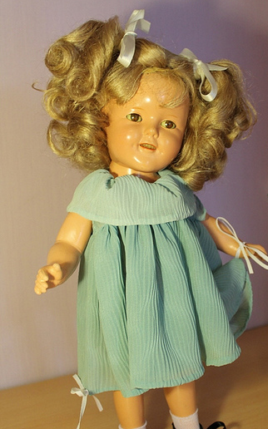
Mom’s Special Doll 妈妈的特别洋娃娃

Slide 26
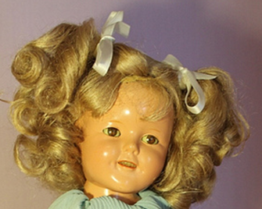
“I think somebody in China would also like to have a doll”
我觉得中国也有人会喜欢一个洋娃娃

Slide 27
Prayer 祷告
O give us homes built firm upon the Savior,
Where Christ is Head and Counsellor and Guide;
Where every child is taught His love and favor
And gives his heart to Christ, the crucified:
How sweet to know that though his footsteps waver
His faithful Lord is walking by his side!
求赐我们家坚立在救主的磐石上，
以基督为首、为师、为引导；
每个孩子都蒙救主恩典与慈爱，
愿意将心献给被钉的主基督；
多么甘甜，知他虽偶有偏行，
信实的主仍伴他一路同行

Slide 28
Prayer 祷告
O give us homes with godly fathers, mothers,
Who always place their hope and trust in Him;
Whose tender patience turmoil never bothers,
Whose calm and courage trouble cannot dim;
A home where each finds joy in serving others,
And love still shines, though days be dark and grim.
賜給我們有敬虔父母的家庭，
总是将希望和信任寄托在神的身上；
他们的温柔耐心不受动荡困扰，
他们的冷静和勇气不为困境所暗淡；
在家里每个人都在服务他人中找到喜悦，
即使日子阴暗沉重，爱依然闪耀

Slide 29
Prayer 祷告
O Lord, our God, our homes are Thine forever!
We trust to Thee their problems, toil, and care;
Their bonds of love no enemy can sever
If Thou art always Lord and Master there:
Be Thou the center of our least endeavor
Be Thou our Guest, our hearts and homes to share.
哦，主，我们的神，我们的家永远属于祢！
我们将所有的难题、辛劳和忧虑交托给祢；
我们的爱之纽带无人能割断，
如果祢始终是我们的唯一主宰；
愿祢成为我们一切努力的中心，
愿祢成为我们的客人，与我们共享心灵与家园。

Slide 32
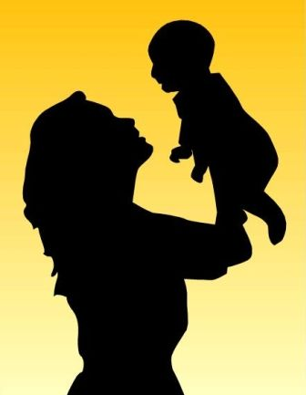
Passing on a Legacy A Grandmother, Mother and a Boy 传承属灵遗产 一位外祖母，一位母亲和一个男孩
II Timothy（提摩太后书） 1:5; 3:14-15; Philippians （腓力比书） 2:20,22

Slide 33
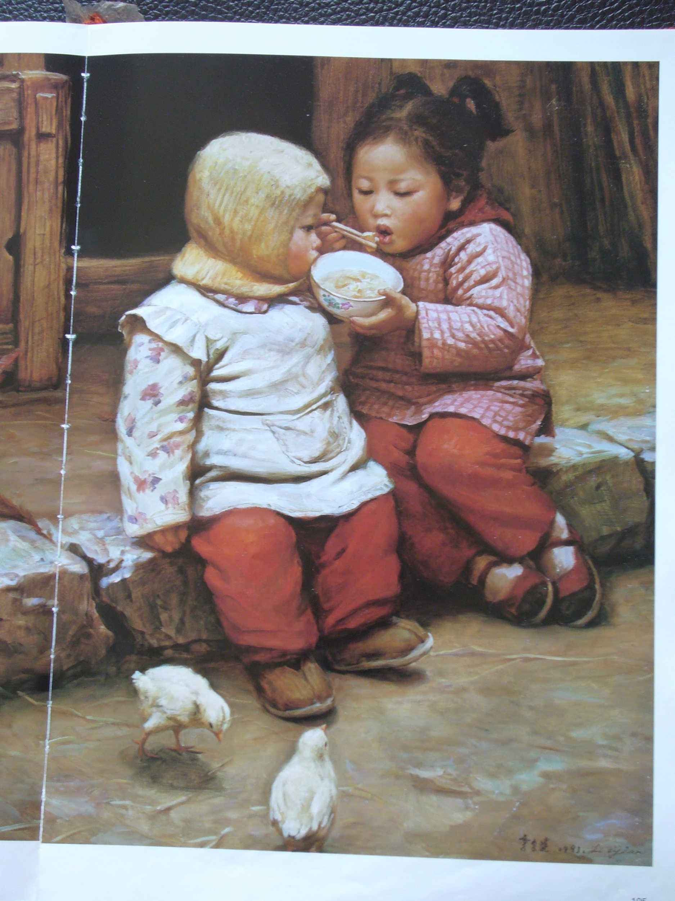
“I was hungry and you fed Me.”
我饿了，你们给我吃

Slide 34
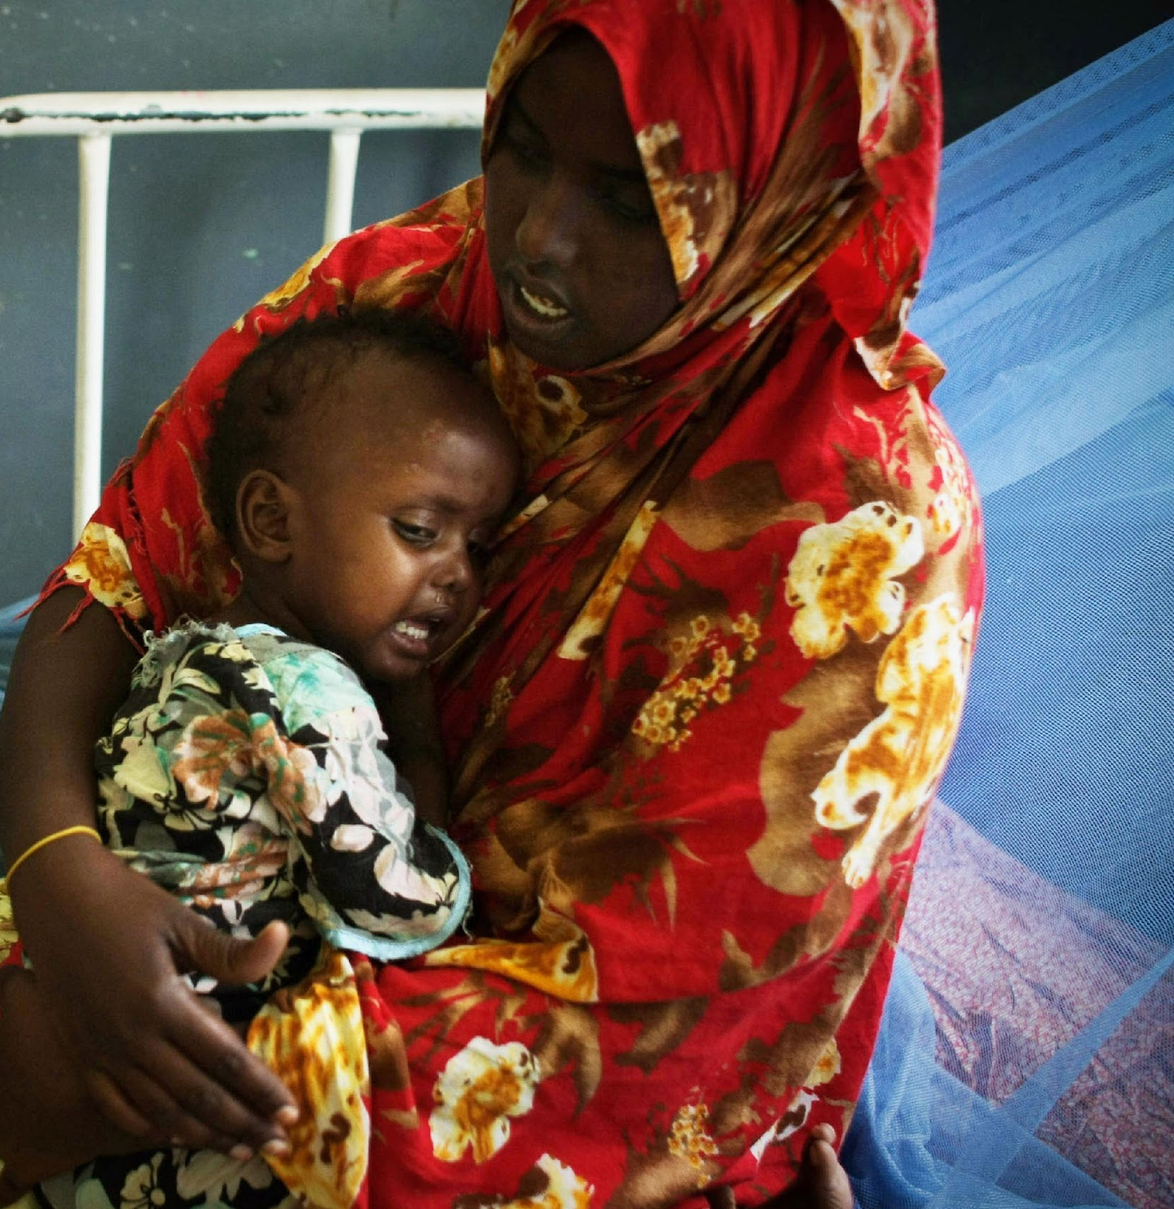
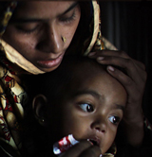
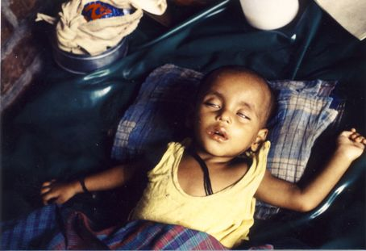

Slide 35
